Slide 1

SEASONAL AGRICULTURE PERFORMANCE ANALYSIS
NAME : DIVYA JAIN
COLLEGE NAME : YMCA New Delhi
AICTE STU ID : STU6a6b5aff7fa0a1785420543

Slide 2

PROBLEM STATEMENT
Agricultural activities are influenced by seasonal variations in environmental conditions, farming practices, resource availability and market conditions. As a result, agricultural performance may differ from one season to another.
However, raw agricultural data does not clearly explain how agricultural performance changes across seasons or what patterns can be observed in different seasonal conditions.
The problem is to analyze the given agricultural dataset and investigate seasonal differences in agricultural performance by identifying meaningful patterns, trends, relationships and variations within the available data.

Slide 3
Project Description
Seasonal Agriculture Performance Analysis is a data analytics project that examines agricultural activities across different seasons, crops, and regions.
The project includes:
Data cleaning, preparation, and exploratory analysis
Analysis of seasonal crop production and yield
Study of rainfall, temperature, humidity, soil, and other environmental factors
Analysis of fertilizer, water, irrigation, and other resource usage
Comparison of crop, state/region, and economic performance
Statistical analysis, visualizations, insights, and recommendations
The final outcome is a data-driven understanding of seasonal agricultural performance.

Slide 4

WHO ARE THE END USERS?
Who Are the End Users?
The analysis can support different stakeholders involved in agricultural decision-making:
Farmers: Understand seasonal performance and improve farming decisions
Government & Agricultural Departments: Support agricultural policies and planning
Agricultural Analysts: Identify trends, patterns, and performance variations
Resource Planners: Improve water, fertilizer, and irrigation planning
Researchers & Agricultural Organizations: Study environmental and seasonal impacts

Slide 5

Technology Used
Technology / Tools:
Python – Data cleaning, preprocessing and analysis
Pandas – Data manipulation and analysis
NumPy – Numerical operations
Matplotlib – Data visualization
Seaborn – Statistical visualization
SciPy – Statistical & Correlation Analysis
Jupyter Notebook / Google Colab – Development environment
CSV – Dataset format

Slide 6
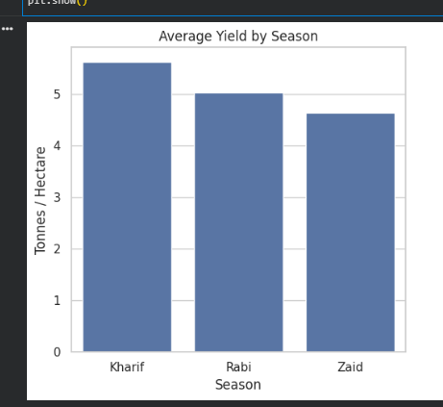
RESULT #1
Kharif recorded the highest average agricultural yield among the analyzed seasons.

Slide 7
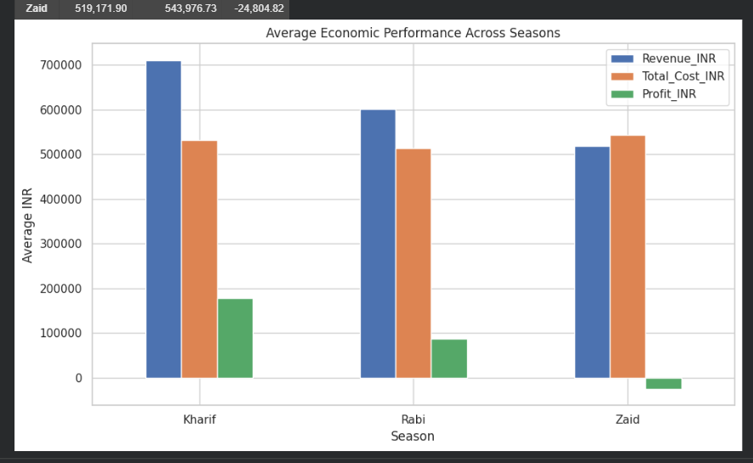
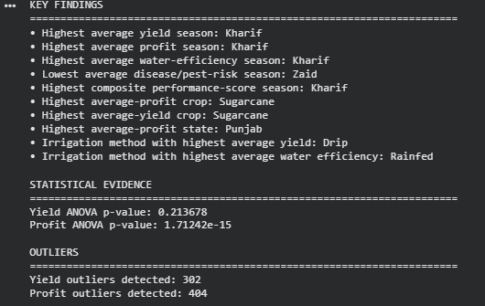
RESULT #2
Kharif recorded the highest average profit. One-way ANOVA confirmed that profit differences across seasons are statistically significant (p = 1.71 × 10⁻¹⁵).

Slide 8
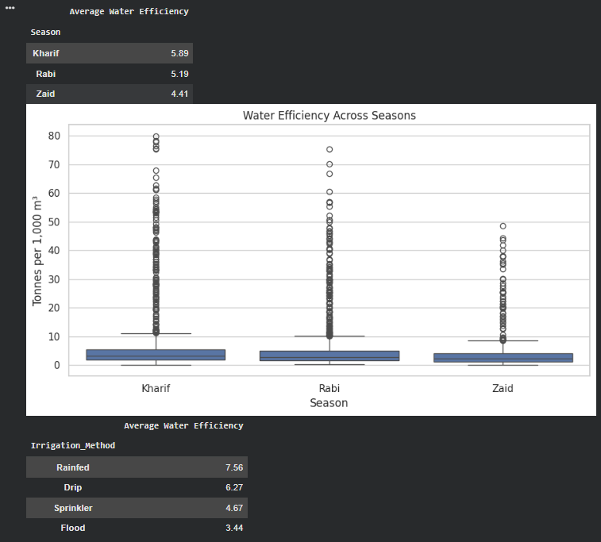
RESULT #3
Kharif demonstrated the highest average water-use efficiency, indicating better output relative to water consumption.

Slide 9
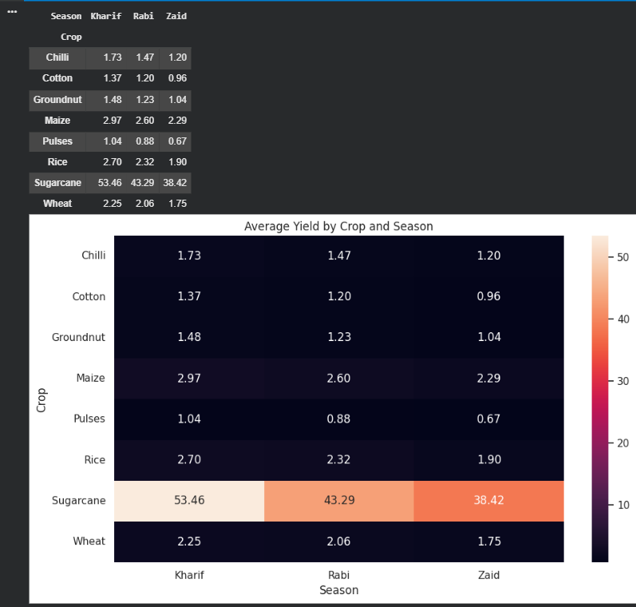
RESULT #4
Crop performance varies across seasons, with Sugarcane showing the highest average yield in the overall crop comparison.

Slide 10
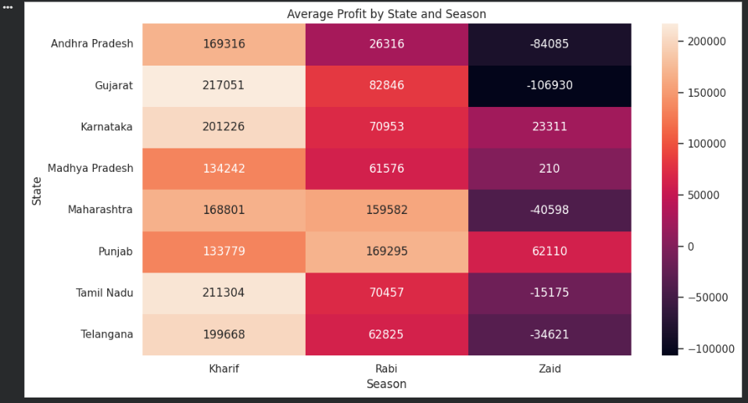
RESULT #5
Punjab recorded the highest average profit, highlighting significant regional variation in agricultural economic performance.

Slide 11
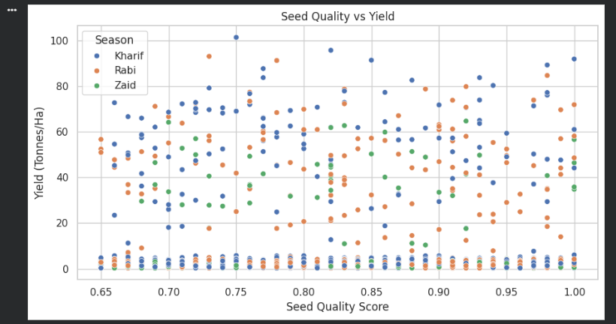
RESULT #6
The scatter plot examines how seed quality is associated with crop yield, helping identify whether better seed quality corresponds to improved agricultural performance.

Slide 12
Future scope
The project can be further enhanced by introducing advanced analytics and real-time data.
Predictive Modeling: Predict crop yield and agricultural performance
Forecasting: Forecast seasonal production, yield, and economic outcomes
Real-Time Weather Data: Incorporate live rainfall, temperature, and weather information
Interactive Dashboard: Develop a Power BI dashboard for real-time exploration
AI-Based Recommendations: Provide recommendations for crops, irrigation, and resource usage
Larger Dataset: Extend the analysis to more regions, crops, and multiple years

Slide 13
GitHub Link
GitHub Link -
https://github.com/Divya870/Seasonal-Agriculture-Performance-Analysis

Slide 14
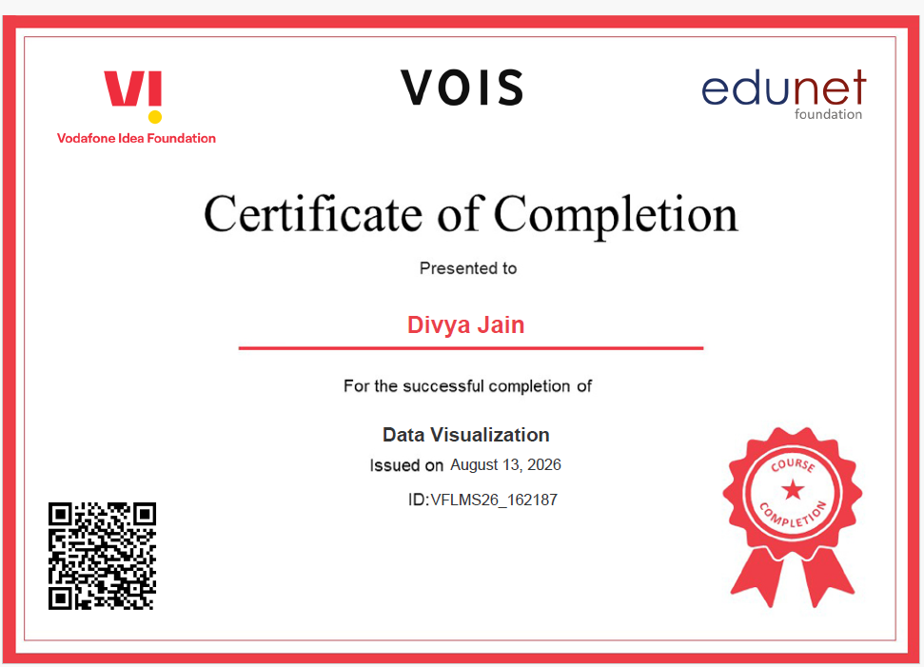
VOIS Course Completion Certificate - DATA VISUALIZATION

Slide 15
THANK YOU
Name: Divya Jain
STU ID: STU6a6b5aff7fa0a1785420543
Internship ID: INTERNSHIP_17830691666a4779eecfe8a

